Slide 1
National Park Biodiversity Data Analysis
Benjamin Sandmann

Slide 2
About the Data
We have two datasets from Codecademy.com named ‘observations.csv’ and ‘species_info.csv’.
The data is fictional but inspired by real data from the National Parks Service.
The 'observations.csv’ dataset contains information on four United States National Parks.
The 'species_info.csv’ dataset contains information on different species found in United States National Parks.

Slide 3
DataSet Breakdown
observations.csv
23,296 Rows 3 Columns
species.csv
5824 Rows 4 Columns
scientific_name – The scientific name of each species
park_name – The name of the National park
observations – The number of observations in the past 7 days
category – The category that each species falls under
scientific_name – The scientific name of each species
common_names – The common names for each species
conservation_status – The species conservation status

Slide 4
ABOUT The Analysis
By analyzing the datasets, we hope to gain some insights into the species that live within the parks and discover relationships within the data that may affect a species respective conservation status.
Conservation Statuses (Greatest risk to Least risk):
Endangered
Threatened
In Recovery
Species of Concern
Not at Risk (Added to the data for analysis purposes)

Slide 5
Question #1 –
How many observations of ‘Not at Risk’ species are there in each park?

Slide 6
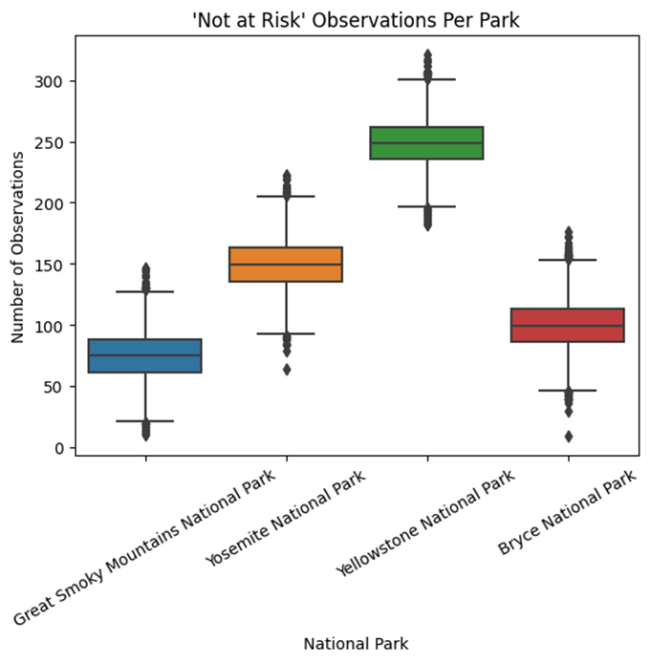

Slide 7
Question #1 Findings –
At first glance, it looks like Yellowstone National Park has significantly more species who are ‘Not at Risk’ compared to the other parks, but this isn’t entirely true.
This poses more questions:
- Why are there more ‘Not at Risk’ species in certain parks and not in others?
- Are some parks more sustainable for wildlife than others?
- Is this only because certain parks have larger populations than others?

Slide 8
Question #2 –
What is the total number of observations in each park?

Slide 9
 | Conservation Status | Endangered | In Recovery | Not at Risk | Species of Concern | Threatened | Total Obsv’s.
Park Name
Bryce National Park |  | 402 | 258 | 533093 | 13979 | 427 | 548,159
Great Smoky Mountains National Park |  | 294 | 189 | 400343 | 9659 | 340 | 410,825
Yellowstone National Park |  | 1008 | 559 | 1337313 | 33569 | 1087 | 1,373,536
Yosemite National Park |  | 616 | 386 | 799611 | 20187 | 672 | 821,472

Slide 10
Question #2 Findings –
When looking at the table in the previous slide, we can see the total observations in each park have a lot of variation.
Each park’s total observations from greatest to least observations:
Yellowstone National Park - - - 1,373,536 Observations
Yosemite National Park - - - 821,472 Observations
Bryce National Park - - - 548,159 Observations
Great Smoky Mountains National Park - - - 410,825 Observations
Look back at the graph and you’ll see this same order is seen when looking at the amount of ‘Not at Risk’ observations in each park.
This means that Yellowstone National Park has more sightings of ‘Not at Risk’ species, not because it is a safer environment for wildlife, but because it has a larger total wildlife population.

Slide 11
Question #3 –
What percent do the observations of each conservation status make up within each park?

Slide 12
 | Conservation Status | Endangered | In Recovery | Not at Risk | Species of Concern | Threatened
Park Name
Bryce National Park |  | 0.073% | 0.047% | 97.252% | 2.55% | 0.078%
Great Smoky Mountains National Park |  | 0.072% | 0.046% | 97.449% | 2.351% | 0.083%
Yellowstone National Park |  | 0.073% | 0.041% | 97.363% | 2.444% | 0.079%
Yosemite National Park |  | 0.075% | 0.047% | 97.339% | 2.457% | 0.082%

Slide 13
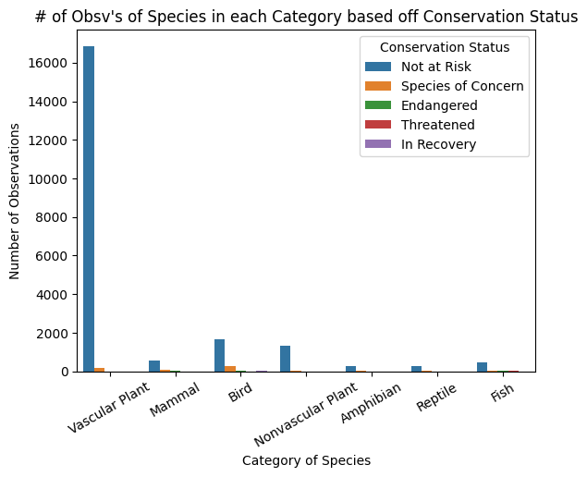
What’s the first thing you noticed when looking at the table on the last slide?
Every park looked nearly identical in terms of the conservation statuses and what percent they made up within each park.
For example, no matter which park you go to, roughly 97% of the parks population will consist of species that are ‘Not at Risk’.
Check out the graph on the left to see a visual comparison of how many sightings of ‘Not at Risk’ species there were compared to species of other conservation statuses.
Wow, that’s a lot, and it’s hard to understand much about the other conservation statuses like this.
For this reason, a lot of the graphs will exclude ‘Not at Risk’ species.

Slide 14
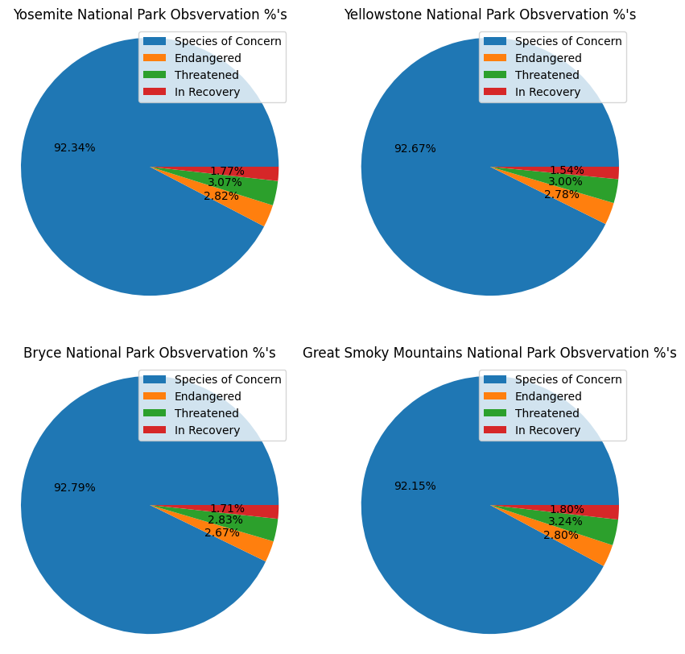
With the ‘Not at Risk’ species removed, we can actually see the distribution of other conservation statuses in each park
Again, you can see that, among these ‘At Risk’ species, each park has an almost identical distribution

Slide 15
Question #3 Findings –
The greatest takeaway is that every park has a near equal percentage of sightings for each conservation status.
We know that the ‘Not at Risk’ species make up most of the sightings of species within each park at roughly 97%.
When you exclude the ‘Not at Risk’ species from the data, the species who are ‘Species of Concern’ (meaning they are at risk, but not significant risk), make up a large portion of sightings in each park at roughly 92%.
Amongst the ‘At Risk’ species, only 2% – 3% of those sightings are of ‘Endangered’ species.
Which leads to my next questions:
What do the observations of ‘Endangered’ species look like?
Less or more sightings on average? No correlation at all?

Slide 16
Question #4 –
Do ‘Endangered’ species have less observations on average?

Slide 17
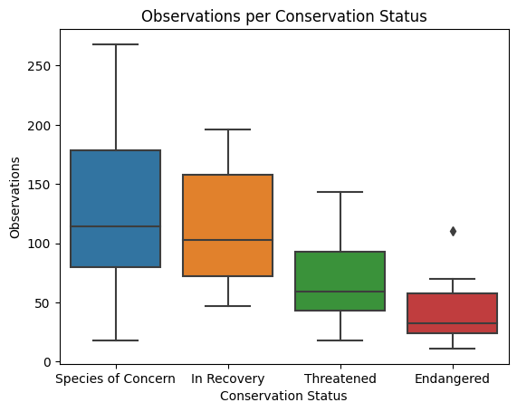
The graph shows all the observations for each species in each conservation status.
In each colored box there is a horizontal line, that line is the average number of observations for that conservation status.
We’re looking at the line in each box to determine if there is a lower amount of observations on average for endangered species.
According to this graph, does this seem to be true?

Slide 18
Question #4 Findings –
According to the graph, it is clear that, on average, ‘Endangered’ species are observed less than any other conservation status.
This makes sense because if the species is ‘Endangered’ then they should have a decreasing population when compared to other species who are not ‘Endangered’.
On average, as the severity of the conservation status increases for a specific species, the sightings of that specific species decreases
For example, if a species goes from being ‘Threatened’ to ‘Endangered’, then the severity of their conservation status has increased.

Slide 19
Moving on from comparing observations and parks, we need to investigate other areas of the data as well.
The focus of the following questions will be directed towards the different categories of species and the conservation statuses of those species.

Slide 20
Question #5 –
What can we learn about categories by looking into the number of species in each conservation status?

Slide 21
Categories of Species
Amphibian
Bird
Fish
Mammal
Nonvascular Plant
Reptile
Vascular Plant

Slide 22
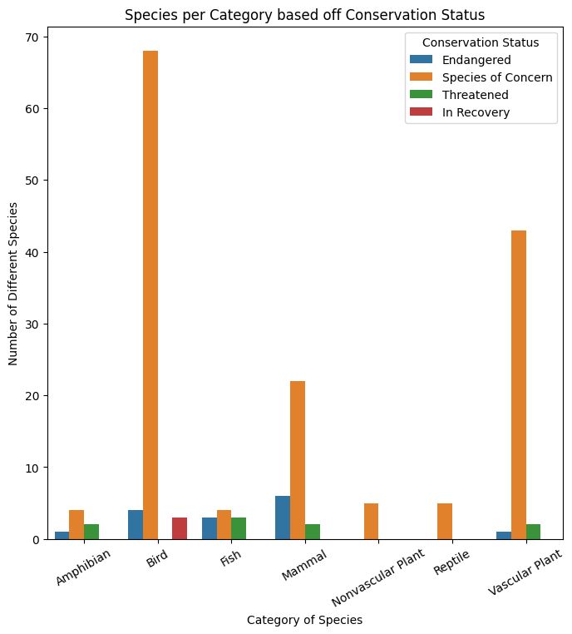

Slide 23
You can clearly see some major differences between the categories of species who are ‘At Risk’!
If you were to rank the categories from greatest to least by how much attention each category needs, then the ranking would be as follows...
1. Bird (Huge concern for nearly the entire category of species)
2. Vascular Plant (Huge concern for nearly the entire category of species)
3. Mammal (Has the most endangered species but far less species who are of concern)
4. Fish (Moderate concern)
5. Amphibian (Moderate concern)
6. Nonvascular Plant & Reptile (No Reptiles or Nonvascular Plants are endangered and very few are of concern)
Let's see if there is an inverse relationship when you plot the number of species which are not at risk.

Slide 24
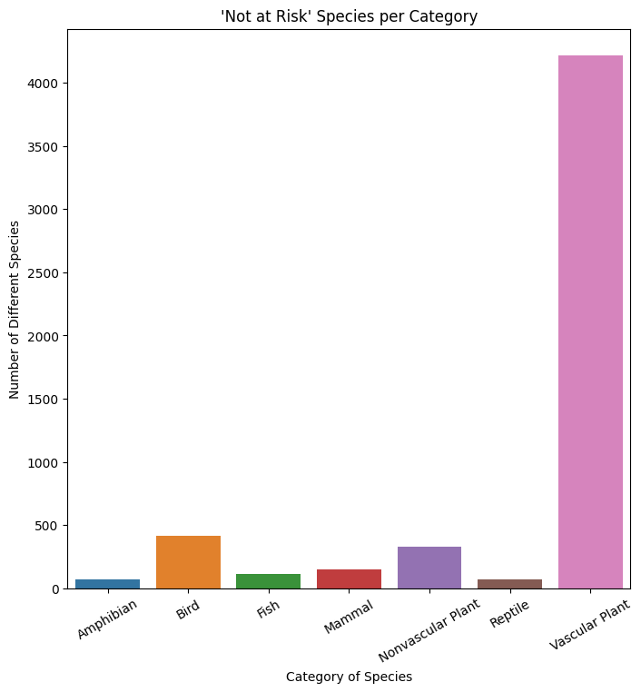

Slide 25
The plot doesn't show us too much, but it does show us that there is a very large amount of Vascular Plant species.
You could spend some time making assumptions and thinking about totals and percentages based off of these two graphs, but a better idea would be to make some more tables!
We will learn more about the data if we can visualize the percentages of the total number of species within each category.

Slide 26
 | Conservation Status | Endangered | In Recovery | Not at Risk | Species of Concern | Threatened | Total Species
Category
Amphibian |  | 1.0 | 0.0 | 72.0 | 4.0 | 2.0 | 79.0
Bird |  | 4.0 | 3.0 | 413.0 | 68.0 | 0.0 | 488.0
Fish |  | 3.0 | 0.0 | 115.0 | 4.0 | 3.0 | 125.0
Mammal |  | 6.0 | 0.0 | 146.0 | 22.0 | 2.0 | 176.0
Nonvascular Plant |  | 0.0 | 0.0 | 328.0 | 5.0 | 0.0 | 333.0
Reptile |  | 0.0 | 0.0 | 73.0 | 5.0 | 0.0 | 78.0
Vascular Plant |  | 1.0 | 0.0 | 4216.0 | 43.0 | 2.0 | 4262.0

Slide 27
 | Conservation Status | Endangered | In Recovery | Not at Risk | Species of Concern | Threatened
Category
Amphibian |  | 1.27% | 0.0% | 91.14% | 5.06% | 2.53%
Bird |  | 0.82% | 0.61% | 84.63% | 13.93% | 0.0%
Fish |  | 2.4% | 0.0% | 92.0% | 3.2% | 2.4%
Mammal |  | 3.41% | 0.0% | 82.95% | 12.5% | 1.14%
Nonvascular Plant |  | 0.0% | 0.0% | 98.5% | 1.5% | 0.0%
Reptile |  | 0.0% | 0.0% | 93.59% | 6.41% | 0.0%
Vascular Plant |  | 0.02% | 0.0% | 98.92% | 1.01% | 0.05%

Slide 28
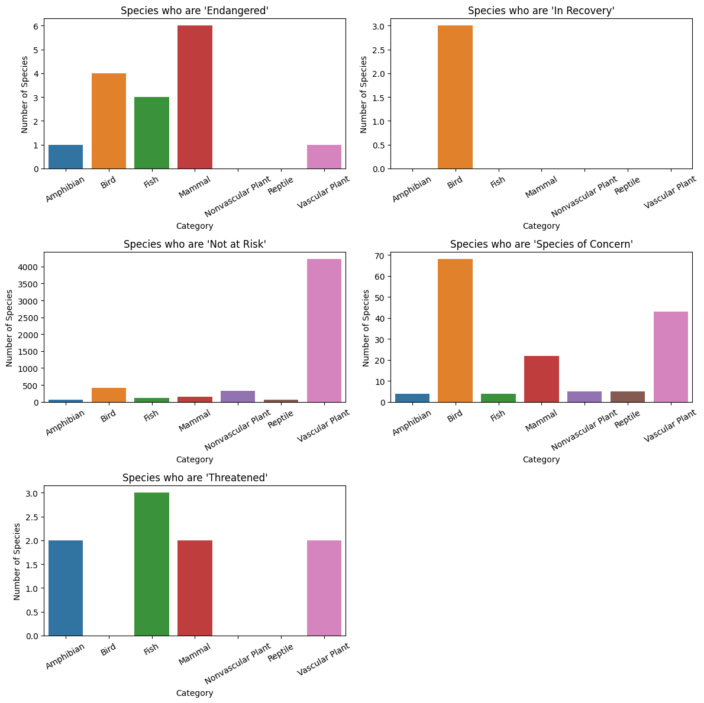

Slide 29
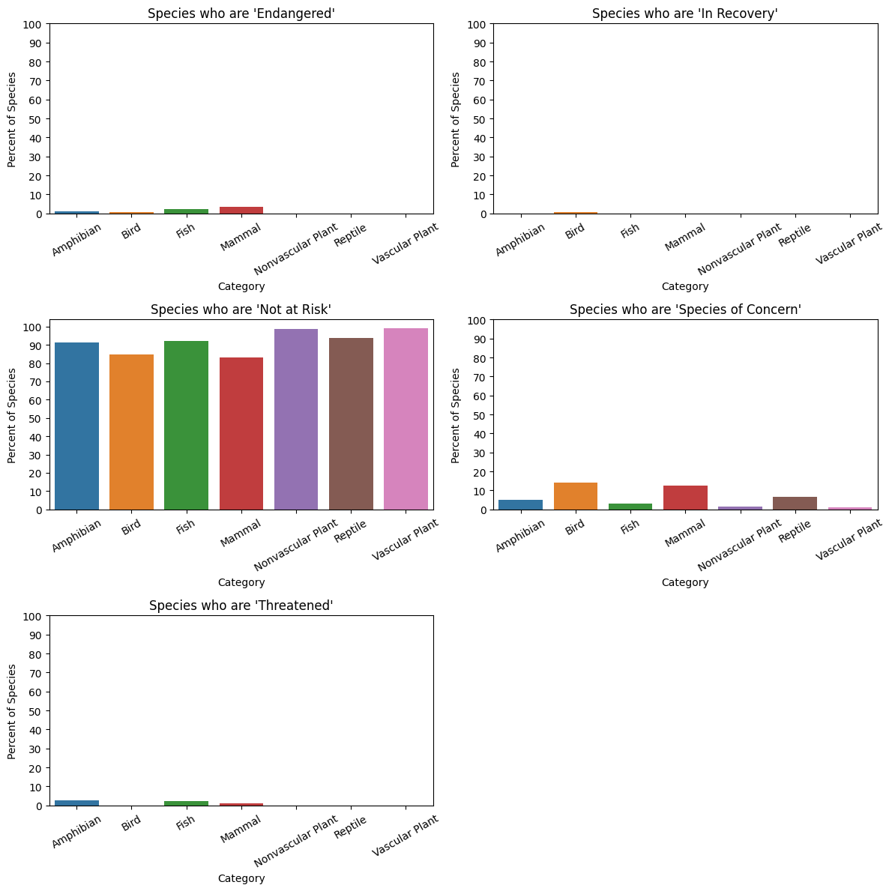

Slide 30
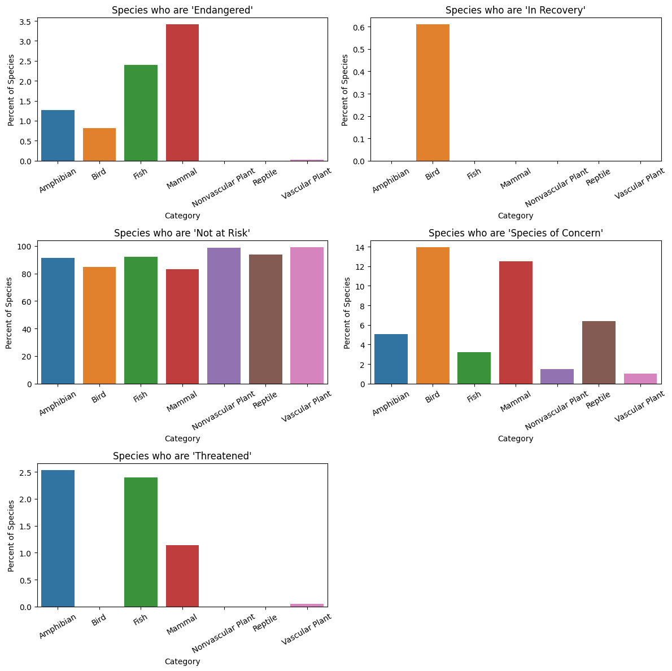

Slide 31
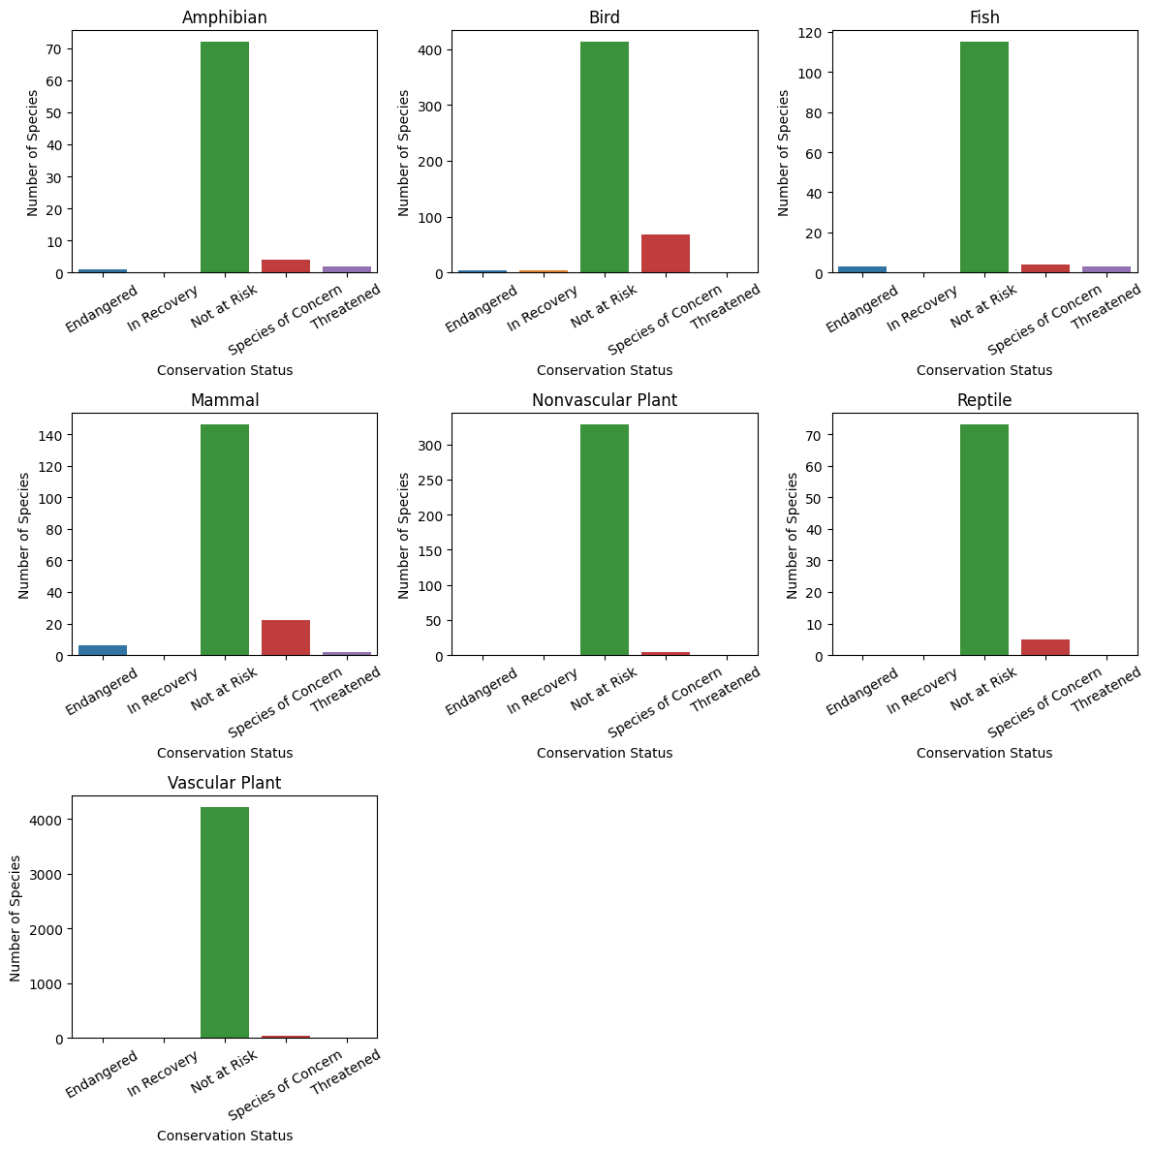

Slide 32
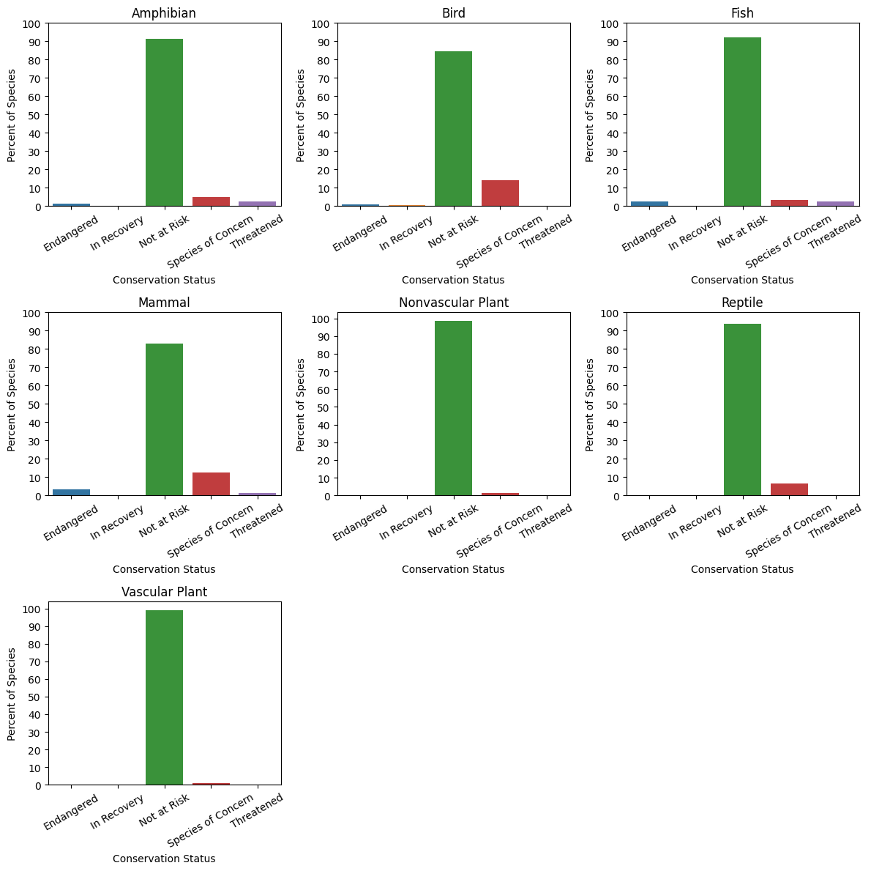

Slide 33
Question #5 Findings –
When comparing all conservation statuses (Includes ‘Not at Risk’)…
Mammals are the most ‘At Risk’ category of species overall
Both Plant categories are the least ‘At Risk’ categories of species overall
Mammals and Fish are the most ‘Endangered’ categories with mammals being the most ‘Endangered’
Birds and Mammals are the categories of species with the most concern with birds having the highest concern
Reptiles have no ‘Endangered’ species but they do have the third highest ‘Species of Concern’ status
Nonvascular Plants have no ‘Endangered’ species

Slide 34
Question #6 –
What happens when we exclude the
‘Not At Risk’ species while analyzing categories and conservation statuses?

Slide 35
 | Conservation Status | Endangered | In Recovery | Species of Concern | Threatened | Total Species
Category
Amphibian |  | 1.0 | 0.0 | 4.0 | 2.0 | 7.0
Bird |  | 4.0 | 3.0 | 68.0 | 0.0 | 75.0
Fish |  | 3.0 | 0.0 | 4.0 | 3.0 | 10.0
Mammal |  | 6.0 | 0.0 | 22.0 | 2.0 | 30.0
Nonvascular Plant |  | 0.0 | 0.0 | 5.0 | 0.0 | 5.0
Reptile |  | 0.0 | 0.0 | 5.0 | 0.0 | 5.0
Vascular Plant |  | 1.0 | 0.0 | 43.0 | 2.0 | 46.0

Slide 36
 | Conservation Status | Endangered | In Recovery | Species of Concern | Threatened
Category
Amphibian |  | 14.29% | 0.0% | 57.14% | 28.57%
Bird |  | 5.33% | 4.0% | 90.67% | 0.0%
Fish |  | 30.0% | 0.0% | 40.0% | 30.0%
Mammal |  | 20.0% | 0.0% | 73.33% | 6.67%
Nonvascular Plant |  | 0.0% | 0.0% | 100.0% | 0.0%
Reptile |  | 0.0% | 0.0% | 100.0% | 0.0%
Vascular Plant |  | 2.17% | 0.0% | 93.48% | 4.35%

Slide 37
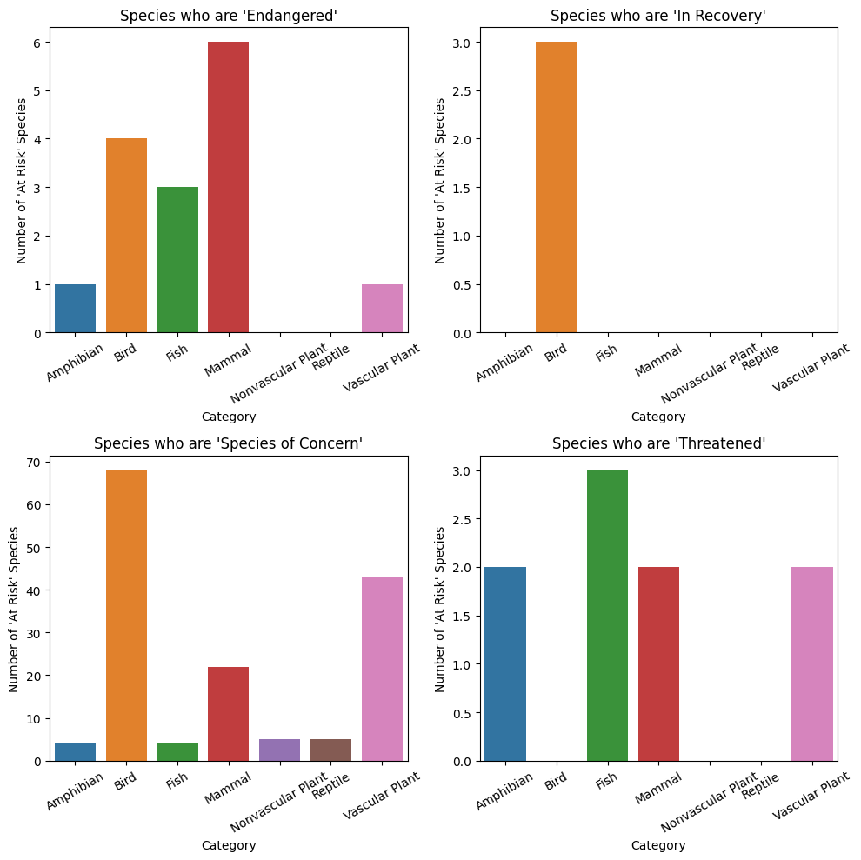

Slide 38
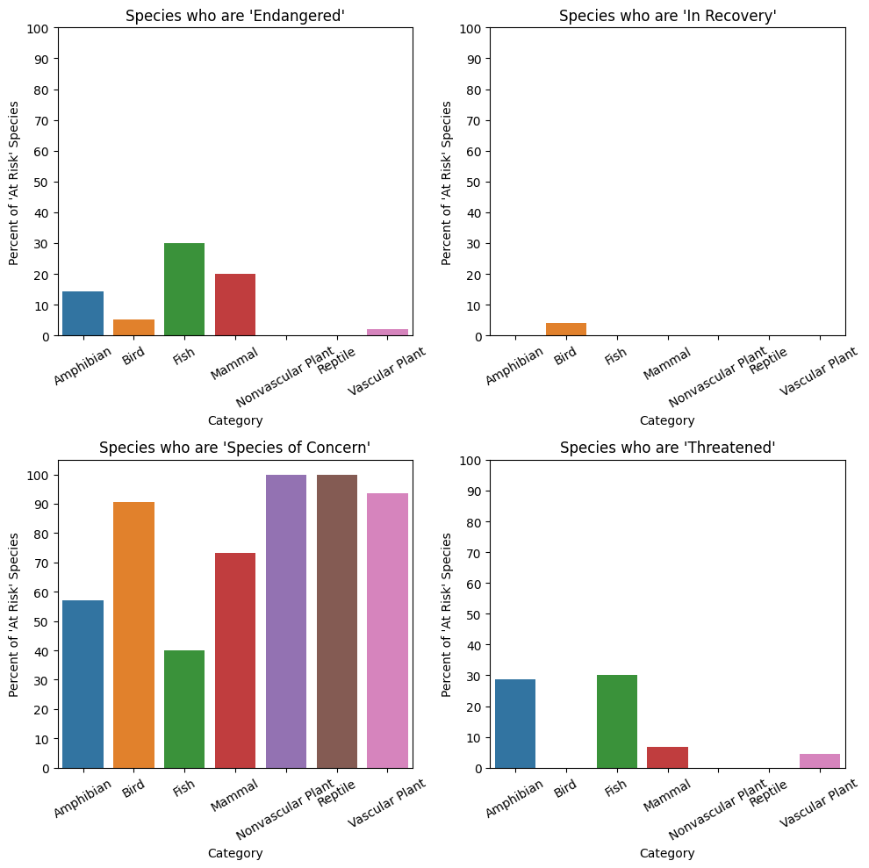

Slide 39
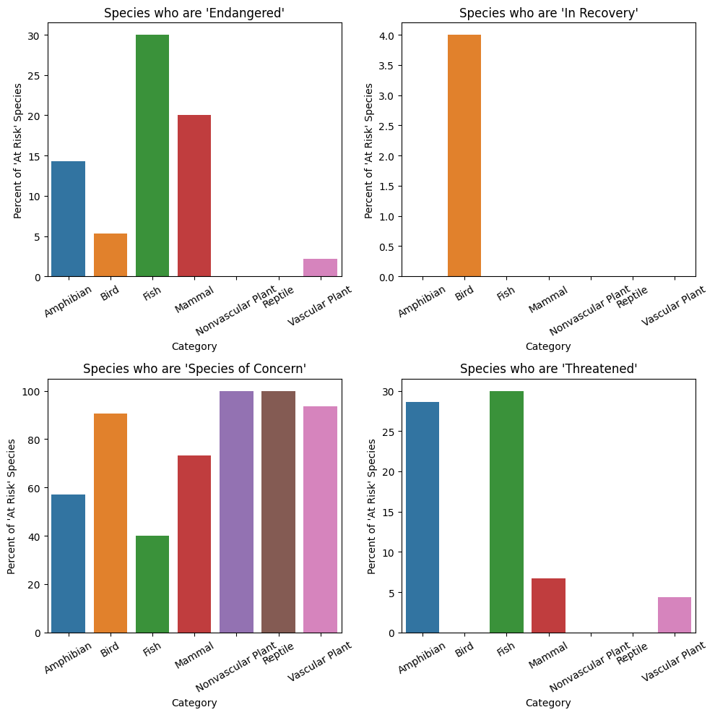

Slide 40
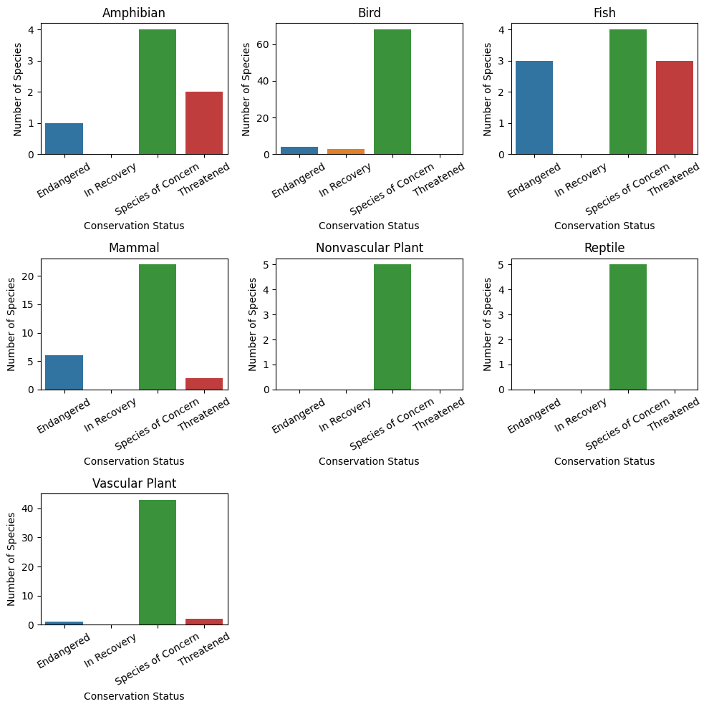

Slide 41
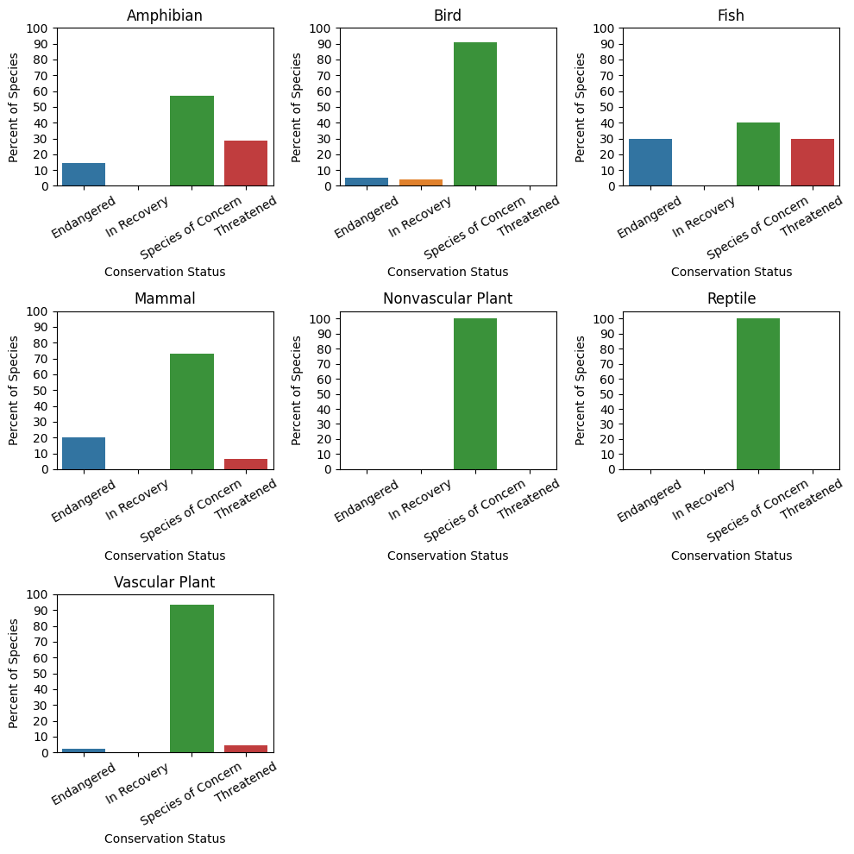

Slide 42
Question #6 Findings –
When comparing ‘At Risk’ conservation statuses (Excludes ‘Not at Risk’)…
Fish have the highest proportion of ‘Endangered’ species (30%) with Mammals being the second highest (20%)
If preventative actions are taken, Birds, Reptiles, Vascular Plants and Nonvascular Plants have a much lower chance of moving towards ‘Endangerment’
Species that live primarily in the water (Amphibians and Fish) have high proportions of ‘Endangerment’ (Amphibians are 3rd highest behind Mammals) and are more ‘Threatened’ than any other category

Slide 43
Question #7 –
What percent do the observations of each category make up within each park?

Slide 44
The focus of this section will be on the number of observations for each category of species in each park.
Very similar to what was analyzed earlier but now instead of looking at the observations for each conservation status, we’ll examine them for each category of species.

Slide 45
 | Category | Amphibian | Bird | Fish | Mammal | Nonvascular Plant | Reptile | Vascular Plant | Total Obsv’s
Park Name
Bryce National Park |  | 7,299 | 48,383 | 12,223 | 16,823 | 32,992 | 7,854 | 422,585 | 548,159
Great Smoky Mountains National Park |  | 5,622 | 35,290 | 9,068 | 12,301 | 24,857 | 5,616 | 318,071 | 410,825
Yellowstone National Park |  | 19,191 | 119,219 | 30,131 | 41,905 | 83,021 | 19,300 | 1,060,769 | 1,373,536
Yosemite National Park |  | 11,309 | 71,290 | 18,353 | 24,887 | 49,783 | 11,335 | 634,515 | 821,472

Slide 46
 | Category | Amphibian | Bird | Fish | Mammal | Nonvascular Plant | Reptile | Vascular Plant
Park Name
Bryce National Park |  | 1.33% | 8.83% | 2.23% | 3.07% | 6.02% | 1.43% | 77.09%
Great Smoky Mountains National Park |  | 1.37% | 8.59% | 2.21% | 2.99% | 6.05% | 1.37% | 77.42%
Yellowstone National Park |  | 1.4% | 8.68% | 2.19% | 3.05% | 6.04% | 1.41% | 77.23%
Yosemite National Park |  | 1.38% | 8.68% | 2.23% | 3.03% | 6.06% | 1.38% | 77.24%

Slide 47
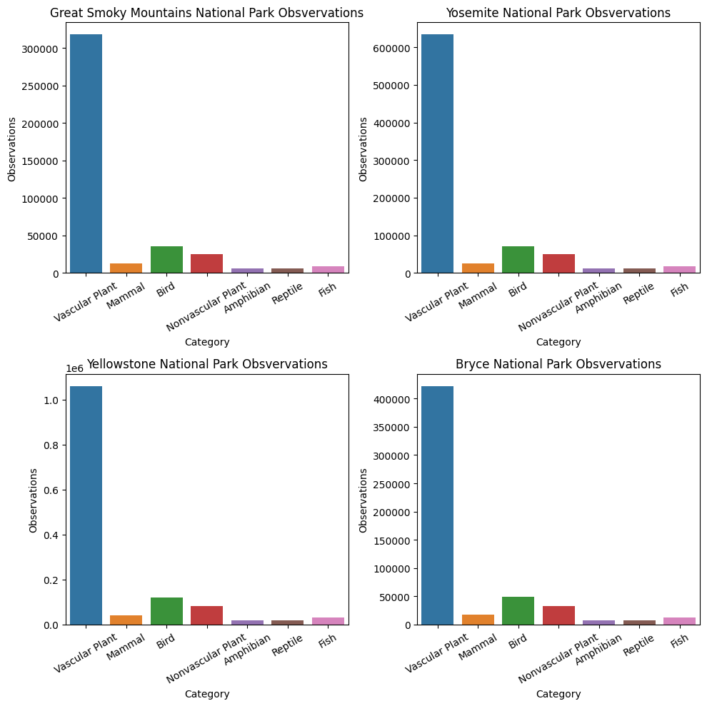

Slide 48
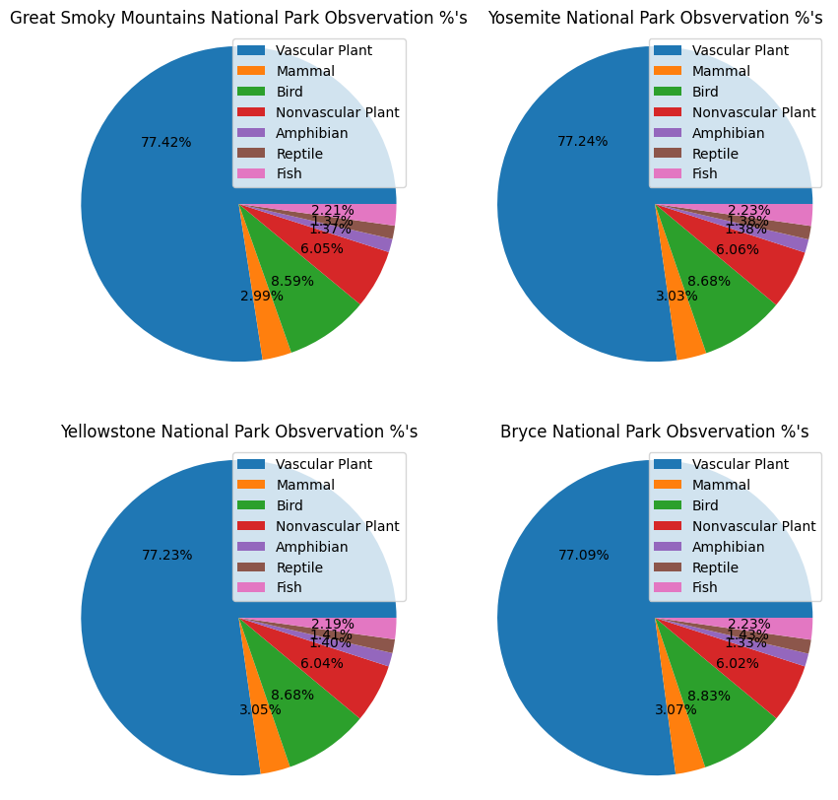

Slide 49
Question #7 Findings –
Just as you discovered earlier with the observations of conservation statuses per park, the percentage of observations of categories from park to park is almost identical.
For example, no matter which National Park you are in, Vascular Plants make up roughly 77% of the species seen within the park.

Slide 50
Question #8 –
What is the most endangered category of species and is this statistically significant?

Slide 51
Referring to a table from earlier…
This table shows the percentage that each conservation status makes up within each category of species
 | Conservation Status | Endangered | In Recovery | Not at Risk | Species of Concern | Threatened
Category
Amphibian |  | 1.27% | 0.0% | 91.14% | 5.06% | 2.53%
Bird |  | 0.82% | 0.61% | 84.63% | 13.93% | 0.0%
Fish |  | 2.4% | 0.0% | 92.0% | 3.2% | 2.4%
Mammal |  | 3.41% | 0.0% | 82.95% | 12.5% | 1.14%
Nonvascular Plant |  | 0.0% | 0.0% | 98.5% | 1.5% | 0.0%
Reptile |  | 0.0% | 0.0% | 93.59% | 6.41% | 0.0%
Vascular Plant |  | 0.02% | 0.0% | 98.92% | 1.01% | 0.05%
This table includes all the species (‘Not at Risk’ species as well) and the Mammal category has the highest percentage of ‘Endangered’ species.
For example, 3.41% of all Mammals are ‘Endangered’.

Slide 52
We know that Mammals have the highest rate of ‘Endangerment’, but to test the significance of this finding (the accuracy of the finding) we will need to do some statistical testing.
The goal is to find out if Mammals have higher rates of ‘Endangerment’ when compared to other categories all the time, or just in this circumstance.
Basically, it’s a test that tests the significance of our finding that Mammals have the highest rate of ‘Endangerment’.
For this test, we’ll be using a Chi-Squared test, which will compare another category to the Mammal category.
For the Chi-Squared test, we’ll need to know the total of species for each category, minus the number of ‘Endangered’ species
The test will be run 6 times, comparing Mammals to another category each time.

Slide 53
 | Conservation Status | Endangered | In Recovery | Not at Risk | Species of Concern | Threatened | Total (Excluding ‘Endangered’)
Category
Amphibian |  | 1.0 | 0.0 | 72.0 | 4.0 | 2.0 | 78.0
Bird |  | 4.0 | 3.0 | 413.0 | 68.0 | 0.0 | 484.0
Fish |  | 3.0 | 0.0 | 115.0 | 4.0 | 3.0 | 122.0
Mammal |  | 6.0 | 0.0 | 146.0 | 22.0 | 2.0 | 170.0
Nonvascular Plant |  | 0.0 | 0.0 | 328.0 | 5.0 | 0.0 | 333.0
Reptile |  | 0.0 | 0.0 | 73.0 | 5.0 | 0.0 | 78.0
Vascular Plant |  | 1.0 | 0.0 | 4216.0 | 43.0 | 2.0 | 4261.0
The actual tests were conducted using Python and a Python library, so the tests won’t be shown, but here is an example of what information the test would need to make a comparison.
For example, if you were comparing Mammals to Fish…
 | Endangered | Total (Excluding ‘Endangered’)
Mammal | 6.0 | 170.0
Fish | 3.0 | 122.0

Slide 54
Before showing test results, we need to first explain what the results are showing.
The results will show a P-value for each category that Mammals get compared to. A P-value is essentially a probability value that describes the probability that an event will occur.
In our case, the event that is occurring is Mammals having a higher percentage of ‘Endangered’ species than another category of species.
The P-value is a confidence measurement, we need a
P-value that is less than 0.05 (5%) to prove that the finding is statistically significant.

Slide 55
Chi-Squared Test Results –
Amphibian P-Value: 0.5795
The difference in the rate of endangerment between Mammals and Amphibian(s) is NOT statistically significant
Bird P-Value: 0.0397
The difference in the rate of endangerment between Mammals and Bird(s) is statistically significant
Fish P-Value: 0.8704
The difference in the rate of endangerment between Mammals and Fish(s) is NOT statistically significant
Nonvascular Plant P-Value: 0.0031
The difference in the rate of endangerment between Mammals and Nonvascular Plant(s) is statistically significant
Reptile P-Value: 0.2292
The difference in the rate of endangerment between Mammals and Reptile(s) is NOT statistically significant
Vascular Plant P-Value: 0.0
The difference in the rate of endangerment between Mammals and Vascular Plant(s) is statistically significant

Slide 56
Question #8 Findings –
Mammals have statistically significant higher rates of endangerment when compared to Birds, Nonvascular Plants, and Vascular Plants (More than 95% of the time)
Being able to explore data come to relevant conclusions is crucial for discovering powerful solutions to problems.
In this instance, we understand that Mammals require more attention than Birds, Nonvascular Plants, and Vascular Plants when it comes to endangerment prevention.
This doesn’t mean that all the other categories don’t need attention as well, just that Mammals most likely need more attention than Birds, Nonvascular Plants, and Vascular Plants, specifically.
For more information on the other categories, we would need to run separate tests for them as well.

Slide 57
Questions/Findings Overview –
Question 1 Finding – At first glance, it looks like Yellowstone National Park has significantly more species who are ‘Not at Risk’ compared to the other parks.
Question 2 Finding – Yellowstone National Park has more sightings of ‘Not at Risk’ species, not because it is a safer environment for wildlife, but because it has a larger total wildlife population.
Question 3 Finding – Every National Park has a near equal percentage of sightings for each conservation status.
Question 4 Findings – 1. On average, ‘Endangered’ species are observed less than any other conservation status.
2. On average, as the severity of the conservation status increases for a specific species, the sightings of that specific species decreases.
Question 5 Findings – When comparing all conservation statuses (Includes ‘Not at Risk’)…
1. Mammals are the most ‘At Risk’ category of species overall.
2. Both Plant categories are the least ‘At Risk’ categories of species overall.
3. Mammals and Fish are the most ‘Endangered’ categories with mammals being the most ‘Endangered’.
4. Birds and Mammals are the categories of species with the most concern with birds having the highest concern.
5. Reptiles have no ‘Endangered’ species but they do have the third highest ‘Species of Concern’ status.
6. Nonvascular Plants have no ‘Endangered’ species.
Question 6 Findings – When comparing ‘At Risk’ conservation statuses (Excludes ‘Not at Risk’)…
Fish have the highest proportion of ‘Endangered’ species (30%) with Mammals being the second highest (20%).
If preventative actions are taken, Birds, Reptiles, Vascular Plants and Nonvascular Plants have a much lower chance of moving towards ‘Endangerment’.
Species that live primarily in the water (Amphibians and Fish) have high proportions of ‘Endangerment’ (Amphibians are 3rd highest behind Mammals) and are more ‘Threatened’ than any other category.
Question 7 Finding – Just as you discovered earlier with the observations of conservation statuses per park, the percentage of observations of categories from park to park is almost identical.
Question 8 Finding - Mammals have statistically significant higher rates of endangerment when compared to Birds, Nonvascular Plants, and Vascular Plants (More than 95% of the time).

Slide 58
THANK YOU
Benjamin Sandmann​
Bsandma1@gmail.com

